Slide 1
Introduction to BlueROV and Simulators
Special Course: Autonomous Marine Robotics

Slide 2
Topics
Introduction
BlueROV (v1 & v2) system overview
Simulators
ArduSub SITL
Unmanned Underwater Vehicle Simulator
Marine Systems Simulator Toolbox (MATLAB)
Activities (ArduSub SITL)
Simulating BlueROV2
Changing BlueROV2 Control State
Understanding the MAVROS interface

Slide 3
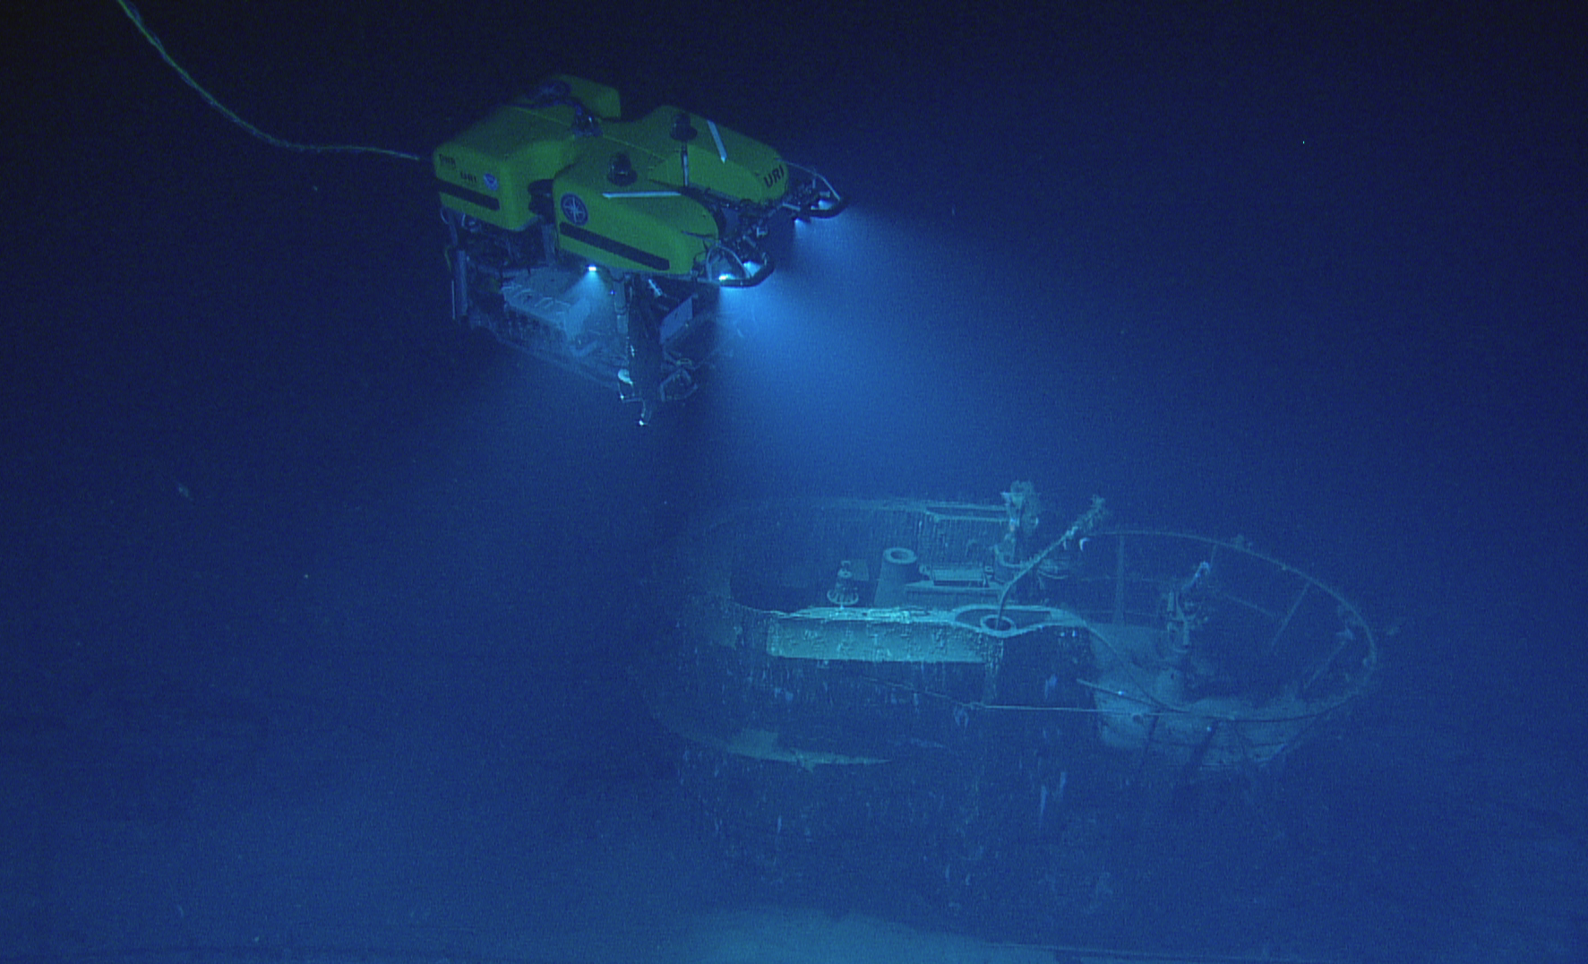
ROV – Remotely Operated Vehicle
Tethered to Control Station
Low Latency Feedback
Vectored Thrusting
Fully/Over-actuated Control
Hydrostatically Stable, but low hydrodynamic efficiency.
Low speeds (< 2 knots)
1 knot ≈ 0.5144 m/s
https://oceanexplorer.noaa.gov/technology/subs/hercules/hercules.html
Nautilus Live: Biologists Live Stream the Benthic
https://www.youtube.com/watch?v=woTi--GCzwM&ab_channel=EVNautilus
Mission to Europa
https://robotik.dfki-bremen.de/en/research/projects/eurex.html
Notes:
Question: This is a german submarine @ 1500 m depth. How did they get this picture?
QUESTION: Knots to m/s, does anybody know?

Slide 4
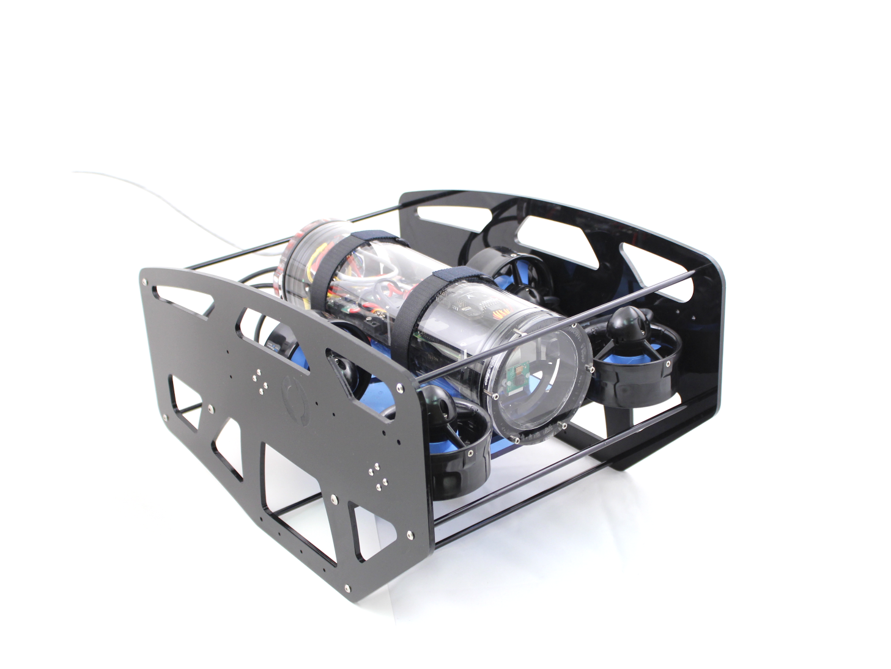
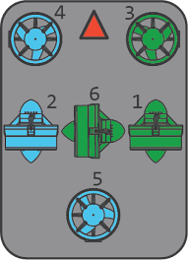
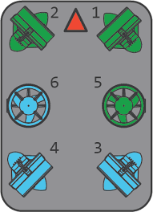
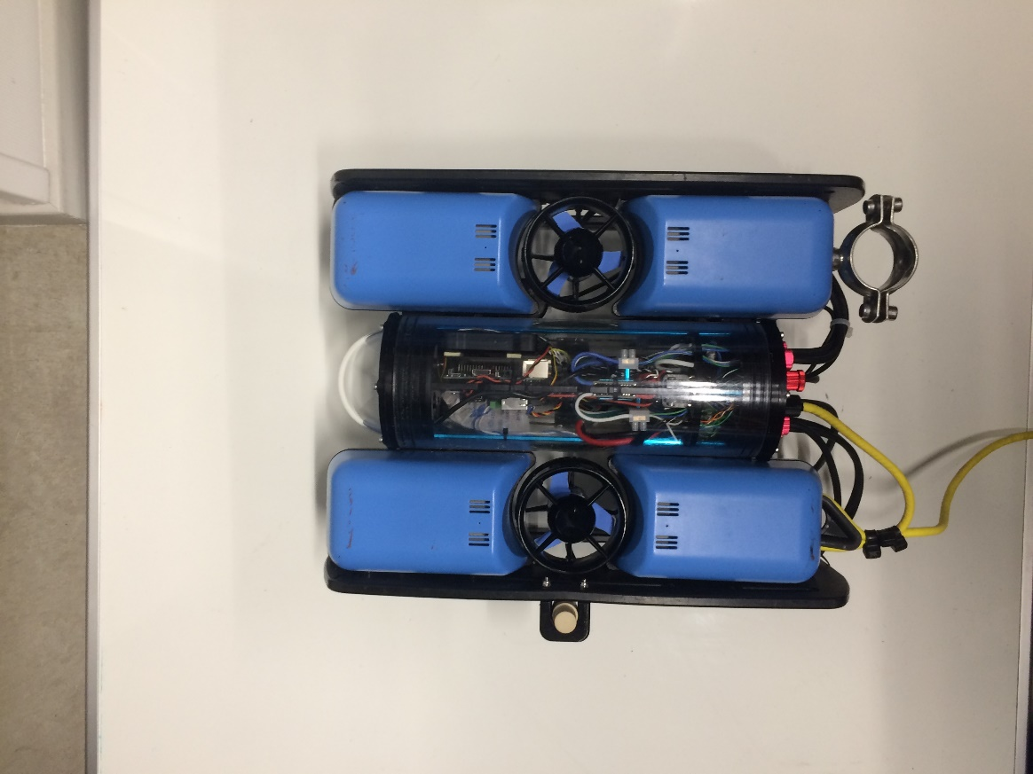
BlueROV
50/50 Open-Source Development, Engineered Sensors & Electronics
Three variants
R1 (1-5 models @ Elektro)
R2 (1-2 models @ Aqua)
R2-Heavy
Frame Configurations

Slide 5
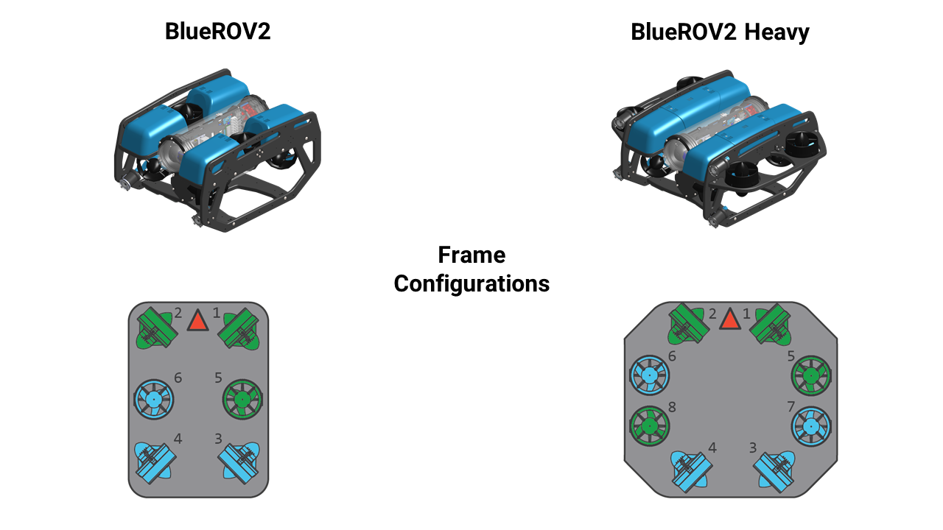
BlueROV

Slide 6
BlueROV Accompanied Flight Controller System
4 Levels of Structure
Sensor Readings & Open Loop Control (Lowest Level)
Hardware State Management & Closed Loop Control (PID)
Advanced Onboard Devices, Proxy Server Interfacing, Highest levels of Onboard Control
Human Machine Interface, Shoreside Processing, External Navigation Aids
F LIGHT
C ONTROLLER
U NIT
C OMPANION
C OMPUTER
G ROUND
C ONTROL
S TATION

Slide 7
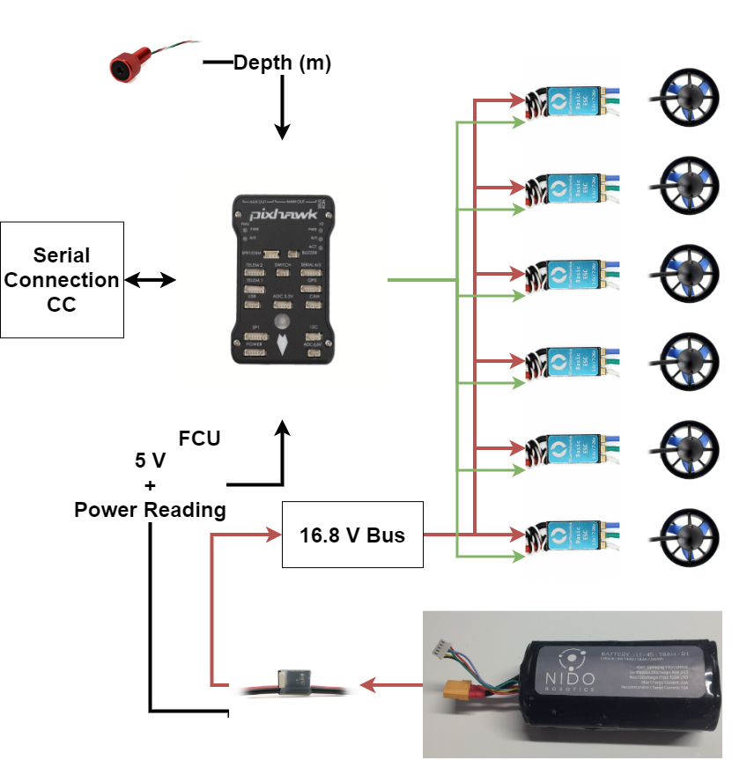
Flight Controller Unit
Microcontroller combined with IMU
Flashed with ArduSub control software
Controls thrusters
Manual Open Loop (Joystick)
Stabilized (Pitch & Roll Closed Loop)
Depth (Stabilized + Depth Closed Loop)

Slide 8
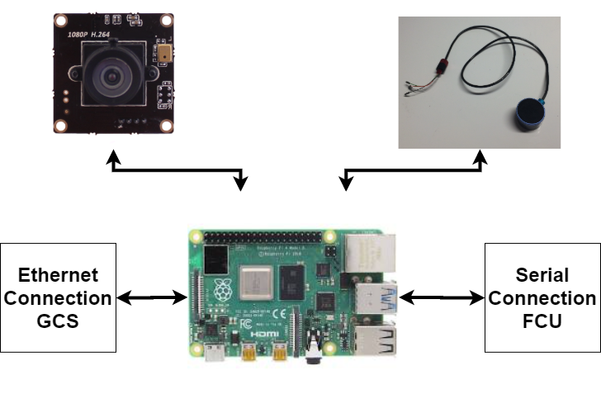


Companion Computer
Embedded System (Raspberry Pi)
Middle-man between FCU and GCS
Extra Sensors (Camera, Altimeter)
Additional Software Packages

Slide 9
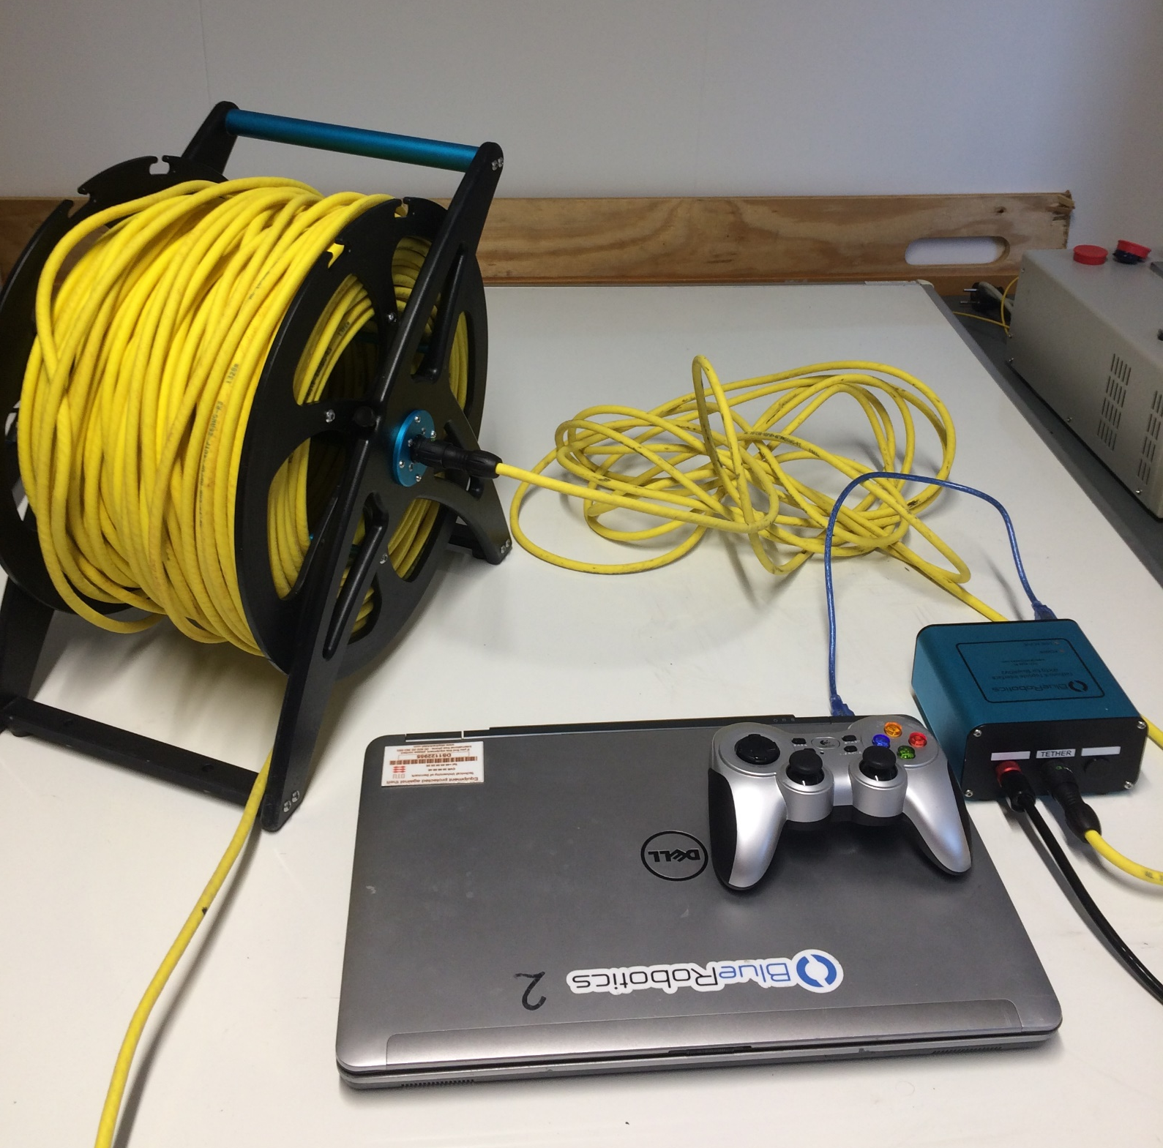
Ground Control (Topside) Station
Human Machine Interface
Joystick
External Navigation Aids
Acoustic Base Line Systems
GPS (Ship or Stationary)
Additional Software Packages
Logging, Video Streaming

Slide 10
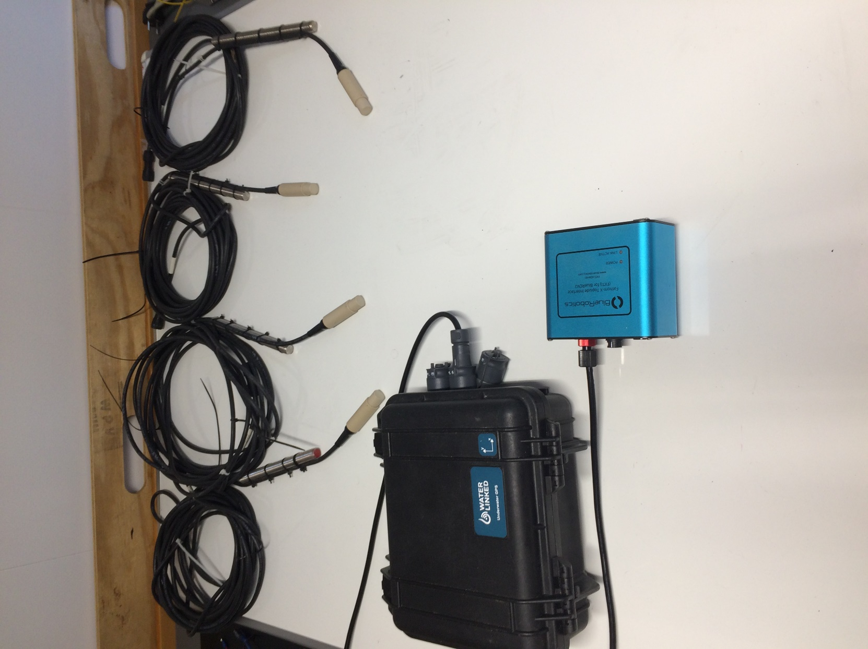
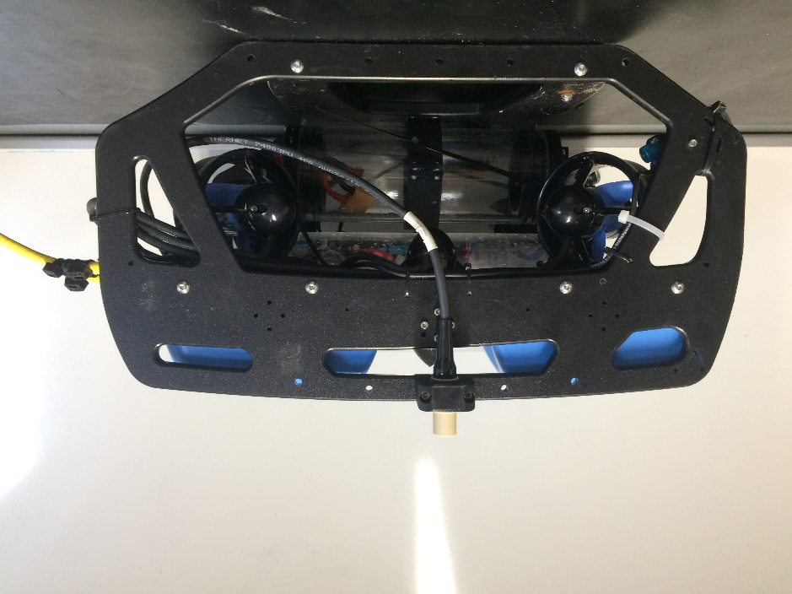
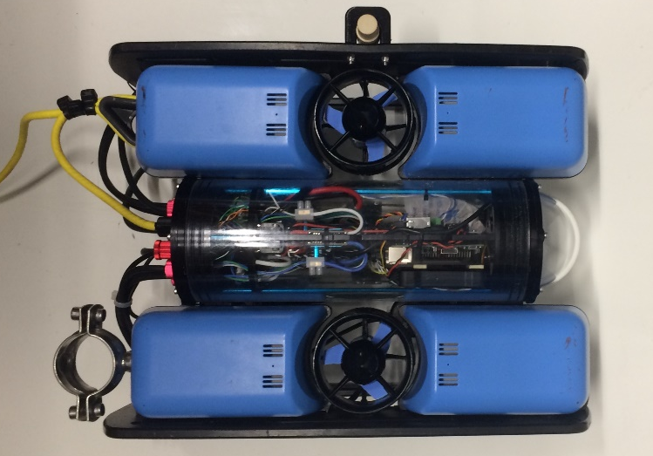
External Navigation Aid
Acoustic Baseline System (“Underwater GPS”)
Long Baseline (LBL)
Short Baseline (SBL)
Ultra-short Baseline (USBL)

Slide 11
Further Reading on BlueROV
In-depth Presentation on BlueROV (Best to Mute): https://slideplayer.com/slide/10977661/
Waterlinked Short Baseline: https://waterlinked.com/underwater-gps/
Blue Robotics Forums: https://discuss.bluerobotics.com/
ArduSub source code: https://github.com/ArduPilot/ardupilot/tree/master/ArduSub
Questions?

Slide 12


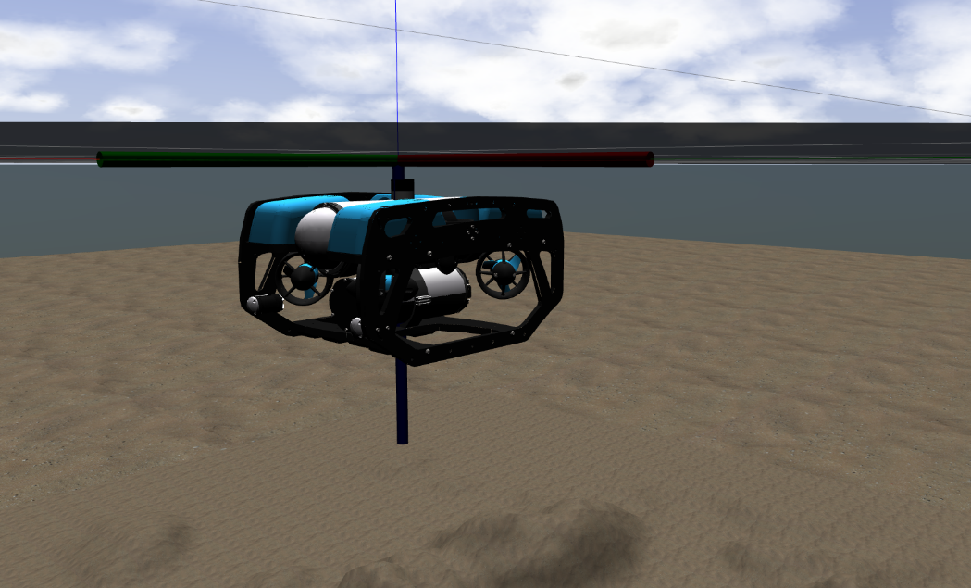
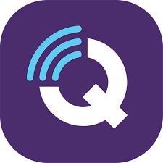
Simulating the BlueROV2
Physics Environment
MAVROS
Interface

Slide 13
Which Simulator is Better?
No Perfect Fit
ArduPilot (ArduSub SITL) | Gazebo (UUV Simulator)
Lightweight (CPU Friendly) | CPU Heavy
Plug & Play (Interchange HW / SW) | No FCU readily available
Modelled to BlueROV2 | Can simulate any vehicle
No Camera | Can simulate cameras, DVL sonar etc.
Simple collision (seabed) | Collision with models
Suggested BlueROV2 “Pain Free“™ Workflow
Design “Amazing System” in ROS with ArduSub backend
Do extensive testing in SITL
Implement on Real Vehicle!

Slide 14
Simulating the BlueROV2
Installation Checklist
Found Open-Source Simulator Software Web Page in DTU Learn
https://github.com/DTUAqua-ObsTek/bluerov2
Installed Ubuntu 20.04 (or virtual machine)
Installed ROS Noetic Ninjemys Desktop
MAVROS
Installed ArduPilot and compiled ArduSub SITL
Installed QGroundControl

Slide 15
Activities!
Make sure to cd into your clone/fork of the bluerov2 repository.
Run the following to pull in the latest changes:
git pull origin master
Navigate to: The BlueROV2 ROS Stack

